Slide 1
SS1 TEAM 7 Dijkstra’s Algorithm
Janesse
Shi Han
Brandon
Liya
Implementation
Analysis
Conclusion
Dijkstra
[Adjacency Matrix]
[Adjacency List]
Time Complexity & Space Complexity

Slide 2
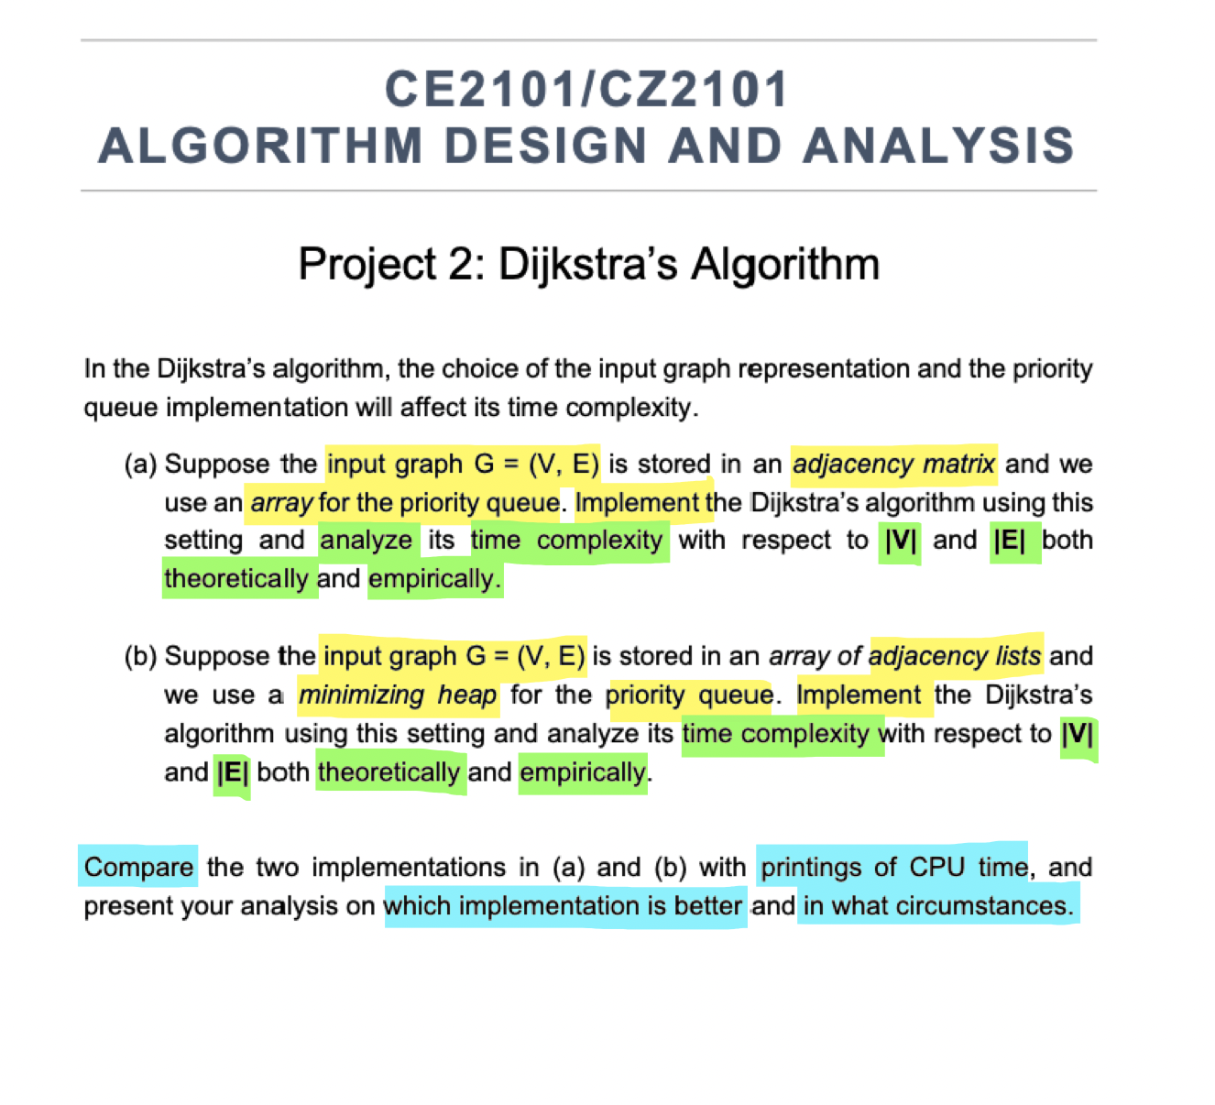
Notes:
Part a
implement algo
- time complexity graph
- key comparison graph
- find optimal S (& sample size)
Part b (Use optimal S)
Implement algo
Time complexity graph
Key comparison graph

Slide 3
(a) Overview
Wrt |V| & |E| [Empirically]
4
CPU Time
Shortest Path
3
Results
Wrt |V| & |E| [Theoretically]
2
Time Complexity
Dijkstra Algorithm
Adj Matrix Implementation
1

Slide 4
(b) Overview
Wrt |V| & |E| [Empirically]
4
CPU Time
Shortest Path
3
Results
Wrt |V| & |E| [Theoretically]
2
Time Complexity
Dijkstra Algorithm
Adj List Implementation
1
Notes:
\

Slide 5
(a) Overview
Dijkstra Algorithm
Adj Matrix Implementation
1

Slide 6
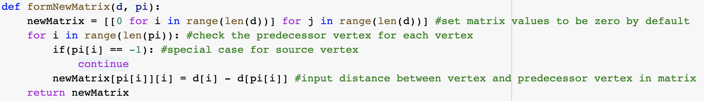
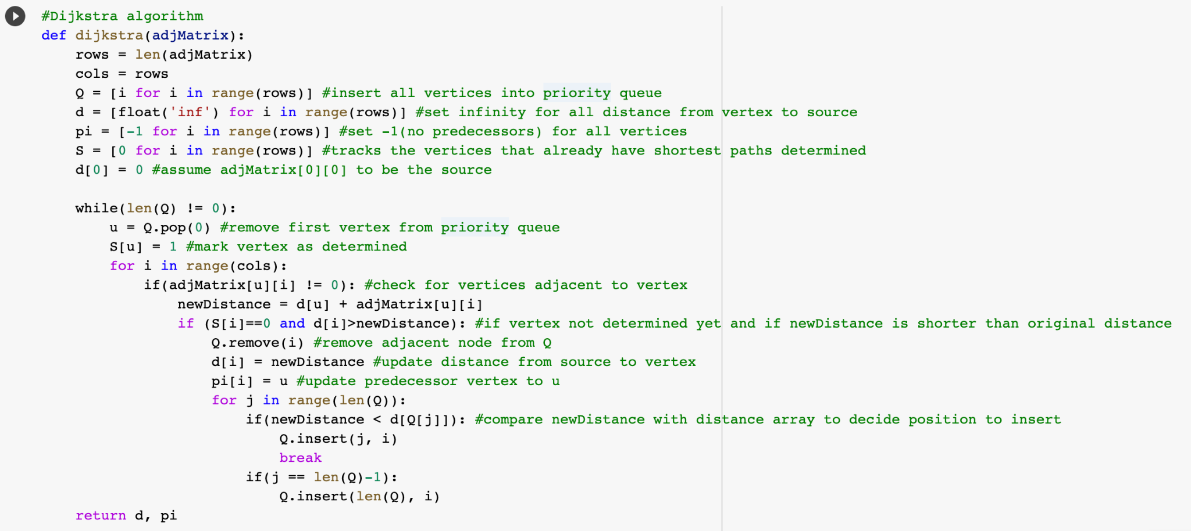
IMPLEMENTATION

Slide 7
Different Circumstances
2018
Case 1
Sparse Graph
2020
Case 2
Complete Graph

Slide 8
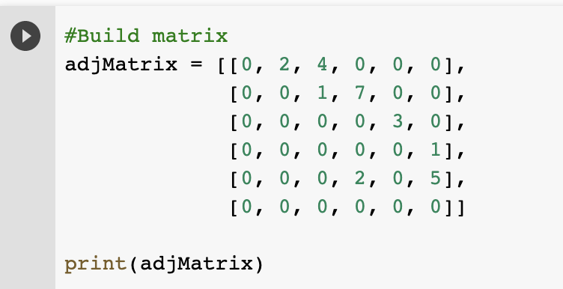
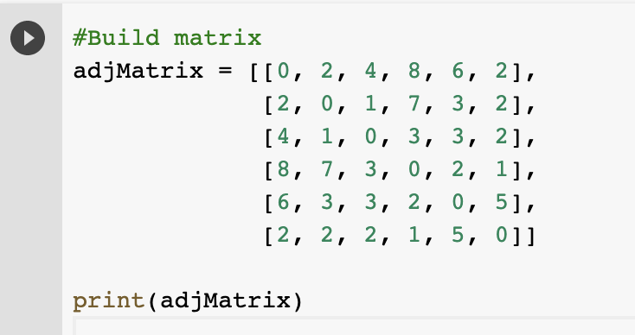
IMPLEMENTATION - Input
2018
2020
Case 1
Case 2
Sparse Graph
Complete Graph

Slide 9
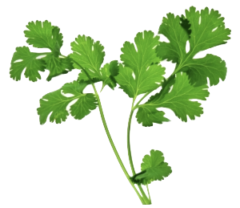
GRAPH - Sparse
1
7
3
1
2
0
1
2
5
4
2
4
5
3
2018
Case 1
Sparse Graph

Slide 10
GRAPH - Completed
1
7
3
2
1
3
2
1
3
8
0
5
2
2
2
6
5
4
2020
2
3
4
Case 2
Complete Graph
Notes:
addEdge(adjList, 0, 1, 2)
addEdge(adjList, 1, 0, 2)
addEdge(adjList, 0, 3, 8)
addEdge(adjList, 3, 0, 8)
addEdge(adjList, 0, 5, 2)
addEdge(adjList, 5, 0, 2)
addEdge(adjList, 0, 4, 6)
addEdge(adjList, 4, 0, 6)
addEdge(adjList, 0, 2, 4)
addEdge(adjList, 2, 0, 4)
addEdge(adjList, 1, 2, 1)
addEdge(adjList, 2, 1, 1)
addEdge(adjList, 1, 4, 3)
addEdge(adjList, 4, 1, 3)
addEdge(adjList, 1, 5, 2)
addEdge(adjList, 5, 1, 2)
addEdge(adjList, 1, 3, 7)
addEdge(adjList, 3, 1, 7)
addEdge(adjList, 3, 2, 3)
addEdge(adjList, 2, 3, 3)
addEdge(adjList, 2, 4, 3)
addEdge(adjList, 4, 2, 3)
addEdge(adjList, 5, 2, 2)
addEdge(adjList, 2, 5, 2)
addEdge(adjList, 3, 4, 2)
addEdge(adjList, 4, 3, 2)
addEdge(adjList, 3, 5, 1)
addEdge(adjList, 5, 3, 1)
addEdge(adjList, 4, 5, 5)
addEdge(adjList, 5, 4, 5)

Slide 11
(a) Overview
Wrt |V| & |E| [Theoretically]
2
Time Complexity
Algorithm
Adj Matrix Implementation
1

Slide 12
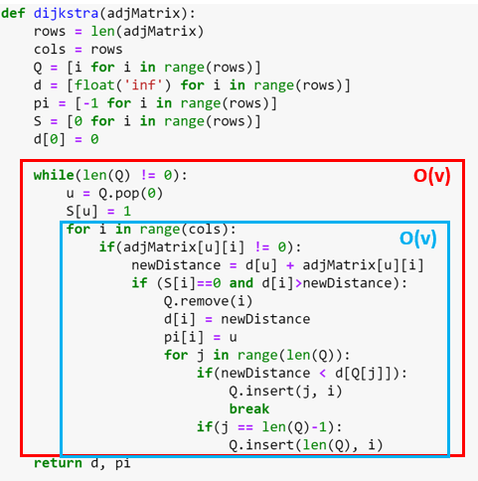
TIME COMPLEXITY

Slide 13
TIME COMPLEXITY
2018
Case 1
Sparse Graph
O(v^2)
2020
Case 2
Complete Graph

Slide 14
(a) Overview
Shortest Path
3
Results
Wrt |V| & |E| [Theoretically]
2
Time Complexity
Dijkstra Algorithm
Adj List Implementation
1
Notes:
\

Slide 15
GRAPH - Sparse
1
7
3
1
2
0
1
2
5
4
2
4
5
3
2018
Case 1
Sparse Graph
Fig 1. (S)parsley

Slide 16
PATH OBTAINED - Sparse
1
3
2
1
0
1
5
2
2
4
3
2018
Case 1
Sparse Graph
Fig 1. (S)parsley
Notes:
D: [0, 2, 3, 8, 6, 9]
0 1 2 3 4 5
Pi: [-1, 0, 1, 4, 2, 3]
newMatrix: [[0, 2, 0, 0, 0, 0], [0, 0, 1, 0, 0, 0], [0, 0, 0, 0, 3, 0], [0, 0, 0, 0, 0, 1], [0, 0, 0, 2, 0, 0], [0, 0, 0, 0, 0, 0]]

Slide 17
GRAPH - Completed
1
7
3
2
1
3
2
1
3
8
0
5
2
2
2
6
5
4
2020
2
3
4
Case 2
Complete Graph
Notes:
#Build matrix
adjMatrix = [[0, 2, 4, 8, 6, 2],
[2, 0, 1, 7, 3, 2],
[4, 1, 0, 3, 3, 2],
[8, 7, 3, 0, 2, 1],
[6, 3, 3, 2, 0, 5],
[2, 2, 2, 1, 5, 0]]
print(adjMatrix)

Slide 18
PATH OBTAINED - Completed
1
3
1
3
2
1
0
5
2
2020
2
4
Case 2
Complete Graph
Notes:
D : [0, 2, 3, 3, 5, 2]
PI: [-1, 0, 1, 5, 1, 0]
[[0, 2, 0, 0, 0, 2],
[0, 0, 1, 0, 3, 0],
[0, 0, 0, 0, 0, 0],
[0, 0, 0, 0, 0, 0],
[0, 0, 0, 0, 0, 0],
[0, 0, 0, 1, 0, 0]]
Time Taken (ns): 270692
D: [0, 2, 3, 3, 1, 2]
Pi: [-1, 0, 1, 0, 0, 0]
newMatrix: [[0, 2, 0, 3, 1, 2], [0, 0, 1, 0, 0, 0], [0, 0, 0, 0, 0, 0], [0, 0, 0, 0, 0, 0], [0, 0, 0, 0, 0, 0], [0, 0, 0, 0, 0, 0]]
Time Taken (ns): 114227

Slide 19
(a) Overview
Wrt |V| & |E| [Empirically]
4
CPU Time
Shortest Path
3
Results
Wrt |V| & |E| [Theoretically]
2
Time Complexity
Dijkstra Algorithm
Adj Matrix Implementation
1

Slide 20
CPU Timing
 | Sparse Graph | Completed Graph
Adjacency Matrix | 106 346 ns | 270 692 ns
1.5x
2018
220
Case 1
Case 2
Sparse Graph
Complete Graph
Notes:
106346

Slide 21
(b) Overview
Wrt |V| & |E| [Empirically]
4
CPU Time
Shortest Path
3
Results
Wrt |V| & |E| [Theoretically]
2
Time Complexity
Dijkstra Algorithm
Adj List Implementation
1

Slide 22
(b) Overview
Dijkstra Algorithm
Adj List Implementation
1

Slide 23
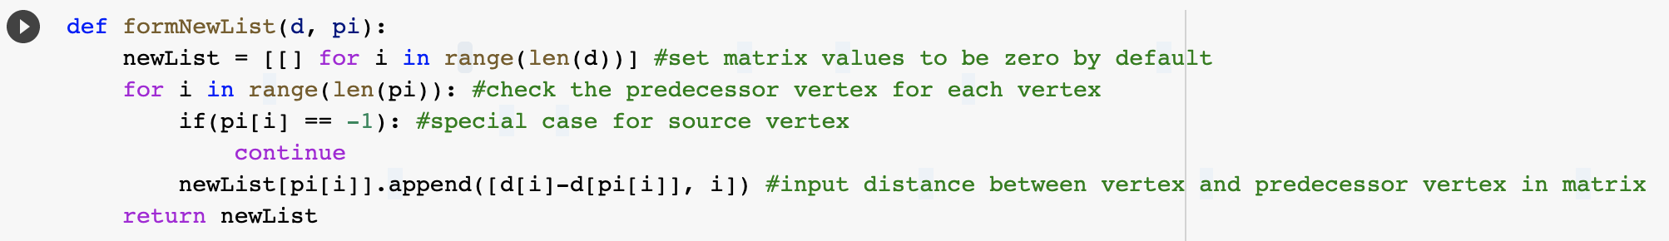
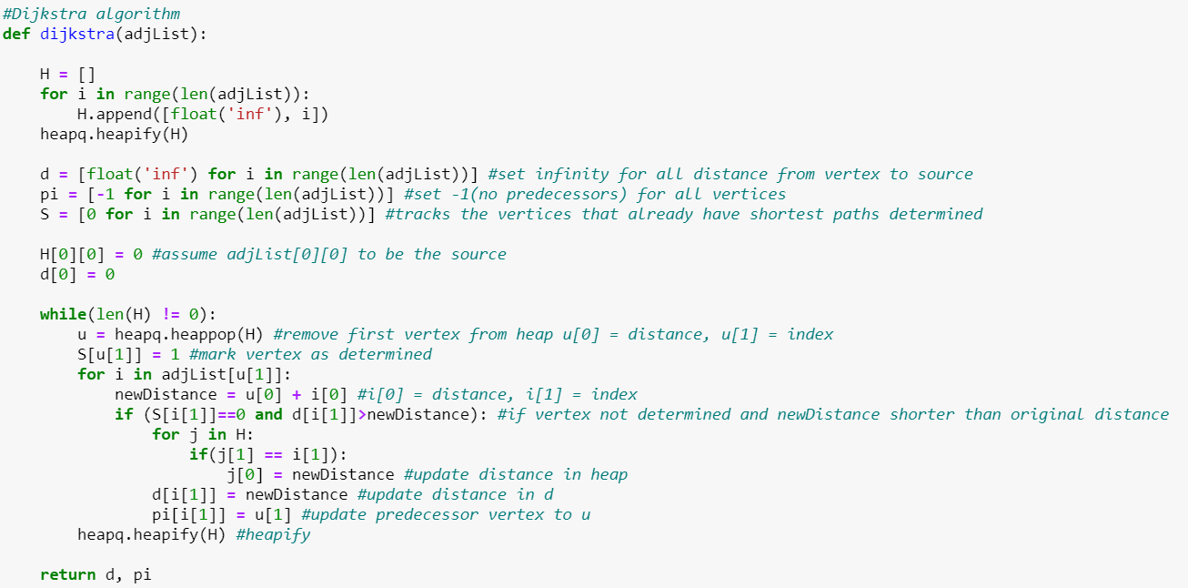
IMPLEMENTATION

Slide 24
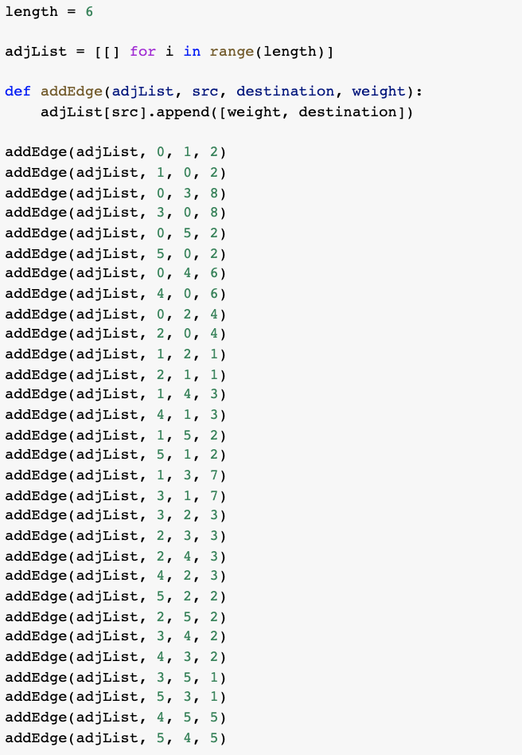
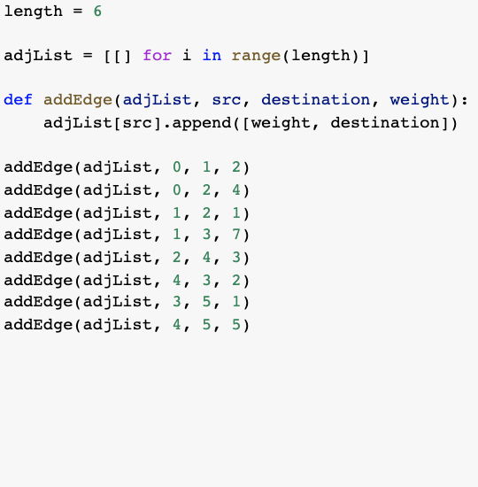
IMPLEMENTATION
2020
2018
Case 2
Case 1
Complete Graph
Sparse Graph

Slide 25
(b) Overview
Wrt |V| & |E| [Theoretically]
2
Time Complexity
Dijkstra Algorithm
Adj List Implementation
1

Slide 26
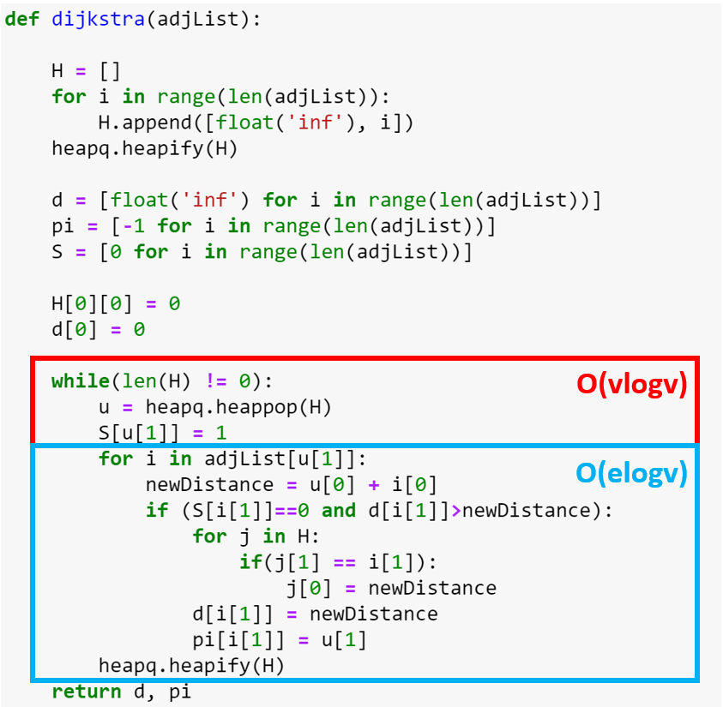
TIME COMPLEXITY

Slide 27
TIME COMPLEXITY
O((v + e) log(v))
2018
Assuming e ≈ v,
=> O(2vlogv)
=> O(vlogv)
Case 1
Sparse Graph
Let e ≈ v(v-1)/2
=> O((v + v(v-1)/2)logv)
=> O((v^2)logv) or O(elogv)
2020
Worst Case!
Case 2
Complete Graph
Notes:
CHANGE

Slide 28
(b) Overview
Shortest Path
3
Results
Wrt |V| & |E| [Theoretically]
2
Time Complexity
Dijkstra Algorithm
Adj List Implementation
1
Notes:
\

Slide 29
GRAPH - Sparse
1
7
3
1
2
0
1
2
5
4
2
4
5
3
2018
Case 1
Sparse Graph
Fig 1. (S)parsley
Notes:
Source, destination, weight
addEdge(adjList, 0, 1, 2)
addEdge(adjList, 0, 2, 4)
addEdge(adjList, 1, 2, 1)
addEdge(adjList, 1, 3, 7)
addEdge(adjList, 2, 4, 3)
addEdge(adjList, 4, 3, 2)
addEdge(adjList, 3, 5, 1)
addEdge(adjList, 4, 5, 5)

Slide 30
PATH OBTAINED - Sparse
1
3
2
1
0
1
5
2
2
4
3
2018
Case 1
Sparse Graph
Fig 1. (S)parsley
Notes:
D: [0, 2, 3, 8, 6, 9]
0 1 2 3 4 5
Pi: [-1, 0, 1, 4, 2, 3]
newMatrix: [[0, 2, 0, 0, 0, 0], [0, 0, 1, 0, 0, 0], [0, 0, 0, 0, 3, 0], [0, 0, 0, 0, 0, 1], [0, 0, 0, 2, 0, 0], [0, 0, 0, 0, 0, 0]]
939298319320
[0, 2, 3, 8, 6, 9]
[-1, 0, 1, 4, 2, 3]
[[[2, 1]], [[1, 2]], [[3, 4]], [[1, 5]], [[2, 3]], []]
939298944907
Time Taken (ns): 625587

Slide 31
GRAPH - Completed
1
7
3
2
1
3
2
1
3
8
0
5
2
2
2
6
5
4
2020
2
3
4
Case 2
Complete Graph
Notes:
addEdge(adjList, 0, 1, 2)
addEdge(adjList, 1, 0, 2)
addEdge(adjList, 0, 3, 8)
addEdge(adjList, 3, 0, 8)
addEdge(adjList, 0, 5, 2)
addEdge(adjList, 5, 0, 2)
addEdge(adjList, 0, 4, 6)
addEdge(adjList, 4, 0, 6)
addEdge(adjList, 0, 2, 4)
addEdge(adjList, 2, 0, 4)
addEdge(adjList, 1, 2, 1)
addEdge(adjList, 2, 1, 1)
addEdge(adjList, 1, 4, 3)
addEdge(adjList, 4, 1, 3)
addEdge(adjList, 1, 5, 2)
addEdge(adjList, 5, 1, 2)
addEdge(adjList, 1, 3, 7)
addEdge(adjList, 3, 1, 7)
addEdge(adjList, 3, 2, 3)
addEdge(adjList, 2, 3, 3)
addEdge(adjList, 2, 4, 3)
addEdge(adjList, 4, 2, 3)
addEdge(adjList, 5, 2, 2)
addEdge(adjList, 2, 5, 2)
addEdge(adjList, 3, 4, 2)
addEdge(adjList, 4, 3, 2)
addEdge(adjList, 3, 5, 1)
addEdge(adjList, 5, 3, 1)
addEdge(adjList, 4, 5, 5)
addEdge(adjList, 5, 4, 5)

Slide 32
PATH OBTAINED - Completed
1
3
1
3
2
1
0
5
2
2020
2
4
Case 2
Complete Graph
Notes:
D : [0, 2, 3, 3, 5, 2]
PI: [-1, 0, 1, 5, 1, 0]
[[0, 2, 0, 0, 0, 2],
[0, 0, 1, 0, 3, 0],
[0, 0, 0, 0, 0, 0],
[0, 0, 0, 0, 0, 0],
[0, 0, 0, 0, 0, 0],
[0, 0, 0, 1, 0, 0]]
Time Taken (ns): 270692
D: [0, 2, 3, 3, 1, 2]
Pi: [-1, 0, 1, 0, 0, 0]
newMatrix: [[0, 2, 0, 3, 1, 2], [0, 0, 1, 0, 0, 0], [0, 0, 0, 0, 0, 0], [0, 0, 0, 0, 0, 0], [0, 0, 0, 0, 0, 0], [0, 0, 0, 0, 0, 0]]
Time Taken (ns): 114227

Slide 33
(b) Overview
Wrt |V| & |E| [Empirically]
4
CPU Time
Shortest Path
3
Results
Wrt |V| & |E| [Theoretically]
2
Time Complexity
Dijkstra Algorithm
Adj List Implementation
1

Slide 34
CPU Timing
 | Sparse Graph | Completed Graph
Adjacency List | 11 584 ns | 266 046 ns
22x
2018
220
Case 1
Case 2
Sparse Graph
Complete Graph
Notes:
106346

Slide 35
Adjacency Matrix vs Adjacency List
CPU Time | Sparse Graph | Completed Graph
Adjacency Matrix (Priority Q) | 106 346 ns | 270 692 ns
Adjacency List (Minimum Heap) | 11 584 ns | 280 046 ns
1.5x
9.18x
1.03x
22x

Slide 36
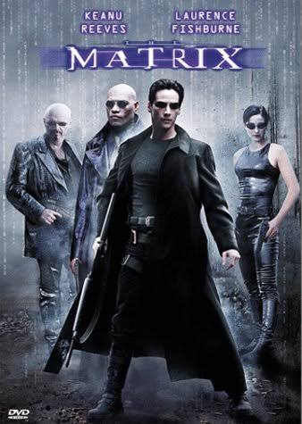

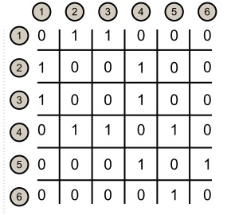
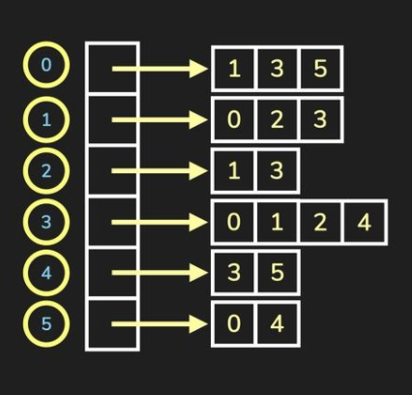
Space Complexity
ADJACENCY MATRIX
ADJACENCY LIST
O(|V|^2)
O(|V| + |E|)

Slide 37
Conclusion
The number of edges
for sparse graph : |E| < |V^2|
for dense graph : |E| ~ |V^2|
Given a dense graph, adjacency matrix is much more suitable as it utilises the memory more efficiently.
Conversely, for a sparse graph, adjacency list is more suitable as it results in a lower time complexity of O(|V|log|V|) and space complexity O(|V|+|E|), as opposed to O(|V|^2).
We also noted that, for a sparse graph, the efficiency of an Adjacency List is further improved when using a minimum heap priority queue, though the same cannot be said for that of a densely packed graph.

Slide 38

END
Fig 2. Leonardo DiCaprio finally wins an Oscar

